Slide 1
Pre-Calc & trig
Day 66

Slide 2
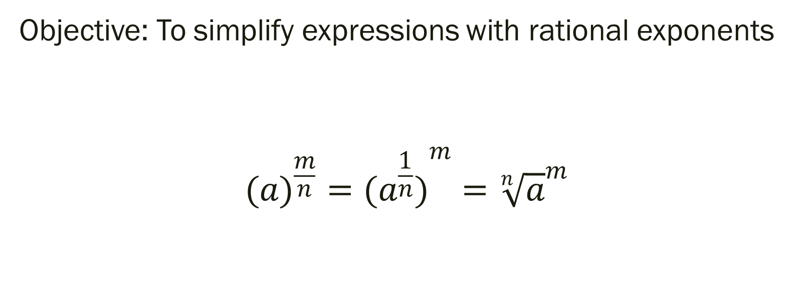
6.4 Rational Exponents
Objective: To simplify expressions with rational exponents
$$({a)}^{\frac{m}{n}}=({a^{\frac{1}{n}})}^{m}={\sqrt[n]{a}}^{m}$$

Slide 3

Simplifying Expressions with Rational Exponents (without a calculator):
${1.) 16}^{\frac{1}{2}}$
$${2.) 27}^{−\frac{2}{3}}$$
$${3.) 5}^{\frac{1}{2}}×5^{\frac{1}{2}}$$
$${4.) 5}^{\frac{1}{4}}×125^{\frac{1}{4}}=$$
$${5.) (−32)}^{\frac{4}{5}}$$

Slide 4
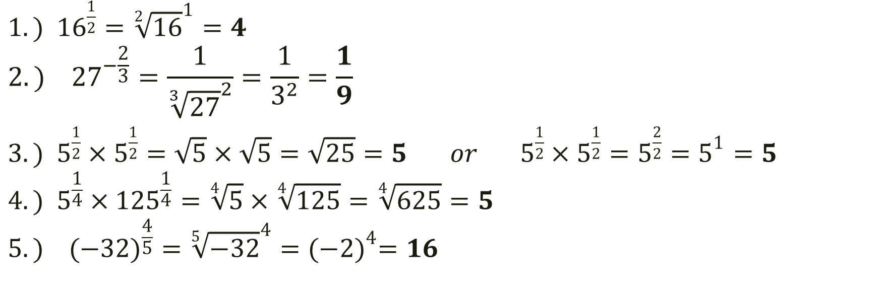
Simplifying Expressions with Rational Exponents:
${1.) 16}^{\frac{1}{2}}={\sqrt[2]{16}}^{1}=4$
$${2.) 27}^{−\frac{2}{3}}=\frac{1}{{\sqrt[3]{27}}^{2}}=\frac{1}{3^{2}}=\frac{1}{9}$$
${3.) 5}^{\frac{1}{2}}×5^{\frac{1}{2}}=\sqrt{5}×\sqrt{5}=\sqrt{25}=5 or { 5}^{\frac{1}{2}}×5^{\frac{1}{2}}=5^{\frac{2}{2}}=5^{1}=5$
$${4.) 5}^{\frac{1}{4}}×125^{\frac{1}{4}}=\sqrt[4]{5}×\sqrt[4]{125}=\sqrt[4]{625}=5$$
$${5.) (−32)}^{\frac{4}{5}}={\sqrt[5]{−32}}^{4}={(−2)}^{4}=16$$

Slide 5
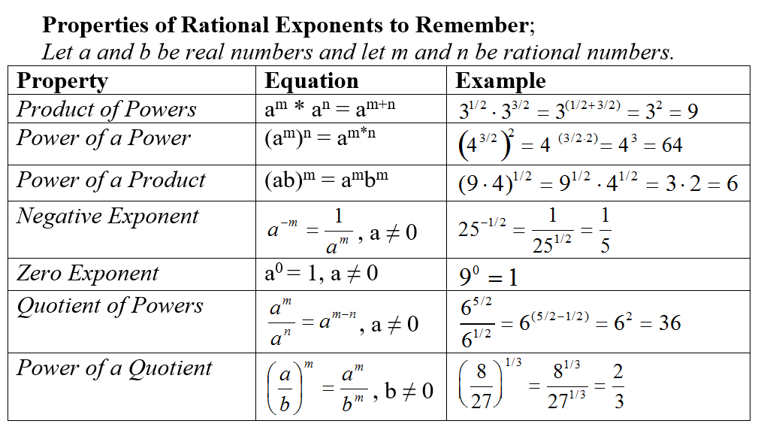

Slide 6
For Next Time:
page 385 #1-6, 8-9, 10-13, 19-22, 33-34, 47-50, 55, 58, 60, 61, 89

